Slide 1

FIGMA TOOL
Group Members:
Kamran Shehzad(029)
Asma Khalid (006)
Mah jabeen Butt (053)
Shahan Imran (023)

Slide 2
OUTLINE
Introduction to Modeling
Purpose and Benefit
Types of Modeling
Introduction to Figma tool
Features of Figma tool
Use of Figma Tool
Pros and Cons of Figma tool

Slide 3
Introduction to Modeling in Software Engineering
Modeling in software engineering refers to the process of creating abstract representations of systems, components, or processes that help developers and stakeholders understand, design, analyse, and communicate the behaviour and structure of a software system. It involves creating diagrams, notations, or prototypes that serve as blueprints for building and managing software.

Slide 4

IMPORTANCE
Communication: Models help to explain complex ideas easily so everyone on the team including non-technical user can also understand.
Problem-solving: Helps in finding the errors , mistakes and issue and it saves time.

Slide 5

IMPORTANCE
Documentation: Models serve as documentation for the system’s design,
helping in maintenance, future development, and debugging.
Validation and verification: Models can be used to check for errors
early in the development process, reducing risks in the later stages.

Slide 6

PURPOSE
The main purpose of modeling in software engineering is to simplify the system design process, improve communication, identify issues early, and ensure the system meets both technical and user requirements.

Slide 7
BENEFITS
I. IMPROVED COMMUNICATION
II. RISK REDUCTION
III. INCREASED EFFICIENCY
IV. FACILITATES COLLABORATION

Slide 8
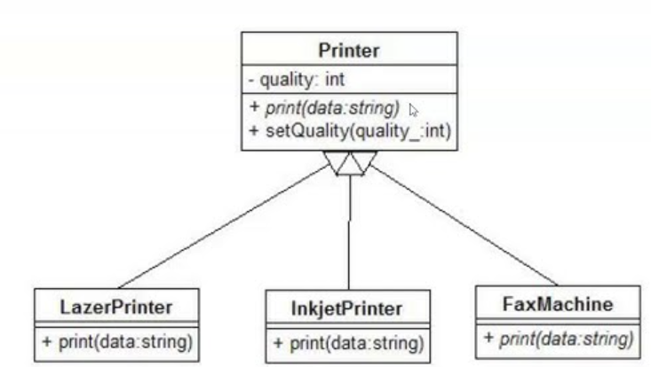
TYPES OF MODELING
Structural Models: These focus on the static aspects of the system, such as the components and their relationships. Example:
Class diagrams (in UML): Show the structure of classes, attributes, and methods.

Slide 9
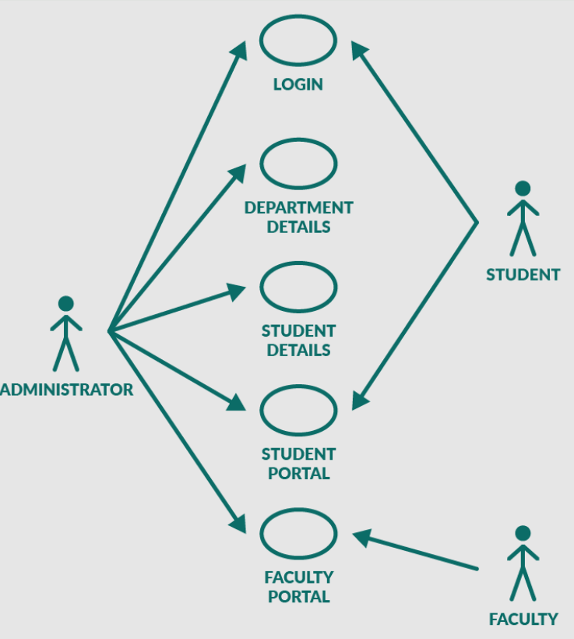
TYPES OF MODELING
Behavioral Models: These describe how the system behaves over time.
Examples include: Use case diagrams (in UML): Show the interactions between users (actors) and the system. Sequence diagrams: Show the interactions between system components in a sequence.

Slide 10
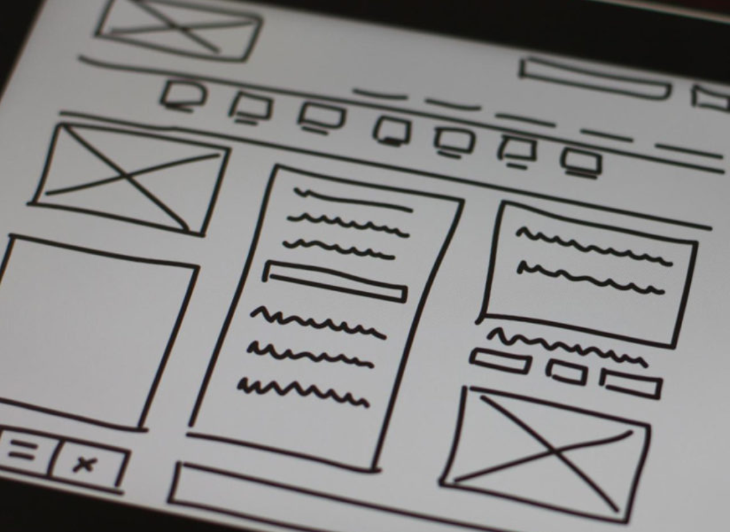
Wireframing
Wireframing is like creating a rough sketch or blueprint of a website or app. It's a basic design that shows where things will go on the screen, like buttons, text, images, and menus.

Slide 11
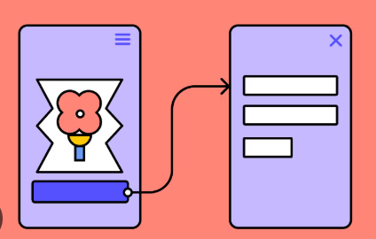
Prototyping
Prototyping is like creating a working version of the website or app. Unlike a wireframe, a prototype shows how the app will actually work. You can click on buttons, navigate through screens, and interact with it—just like a real app, but without all the final designs.

Slide 12

INTRODUCTION TO FIGMA TOOL:
• Figma is a cloud-based design and prototyping tool widely used for wireframing, prototyping and UI design and collaborative modeling.
• Figma is similar to other design tools like sketch and adobe XD with few key difference.
• Figma interface is clean and intuitive with a design that focus in usability.

Slide 13

FEATURES
Collaboration feature
You can work on the same file with others in real time , give comments and get feedbacks

Slide 14
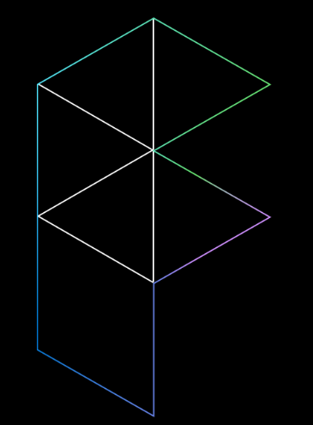
POWERFUL DESIGN SYSTEM
Figma has powerful design system features that create and manage reusable Design components.
This save a lot of time and efforts specially when you are working on a complex project with many different screen and Components.

Slide 15
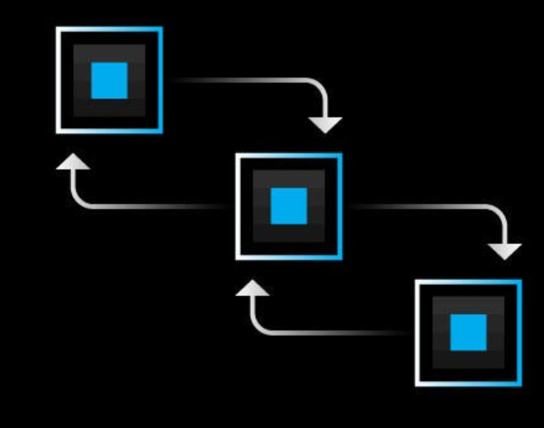
VERSION CONTROL SYSTEM
Another key feature of sigma is its versions control system which
keeps track of changes to your design file . It is helpful when you are
collaborating with others easily back to previous version of your design
if needed

Slide 16

INTEGRATION
Figma also wide range of integrations with other tools
including slack, Trello and github this make it easy to
integrate figma into your existing workflow and collaborate
with other senior teams

Slide 17

ACCESSIBILITY
As Figma is a cloud based, it allows users to access their projects anywhere in the world

Slide 18

USES
It is beneficial for both designers and developers
It is a great tool .It streamline your workflow and work more efficiently with others.
It is used to make Wireframes, prototypes and complete user interfaces

Slide 19
Figma tool demo sign up & sign in page.
.

Slide 20
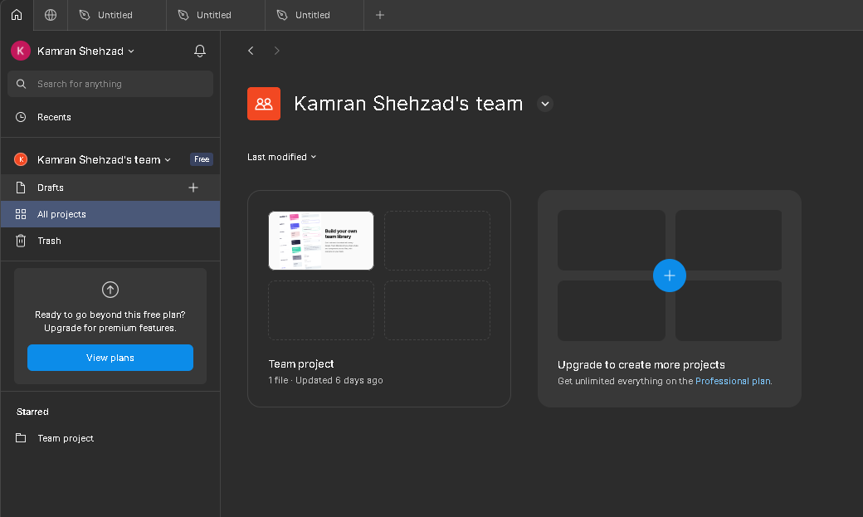
Open figma
When we open the figma tool, it first ask for login.
Then it shows the front page like this.

Slide 21
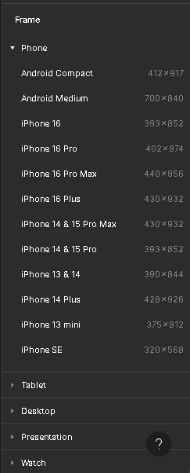
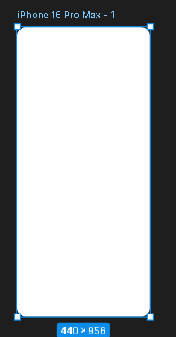
Step 1: Start a new project
Open Figma.
Create a new file.
Select frame to do work.
E.g. iphone 16promax 1

Slide 22
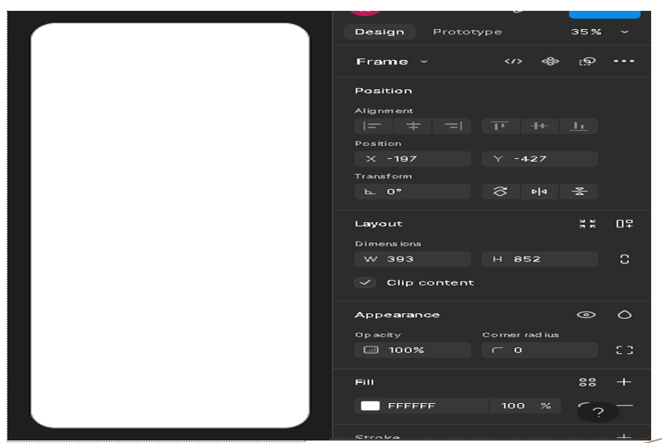
Step 2
Then we make radius of its corner slightly circular y using frame features.

Slide 23
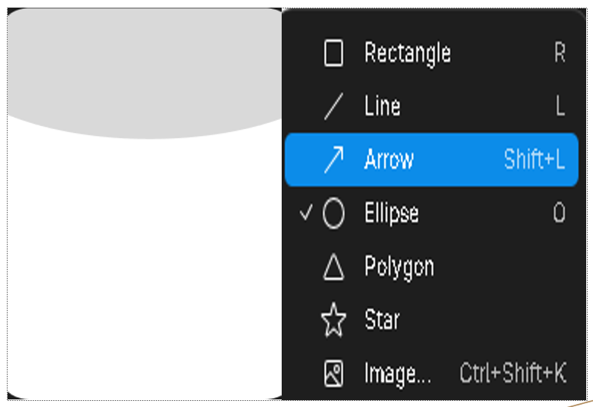
Step 3: Select shape
Then we select a shape from the shape section of figma tool and adjust it in the frame.

Slide 24

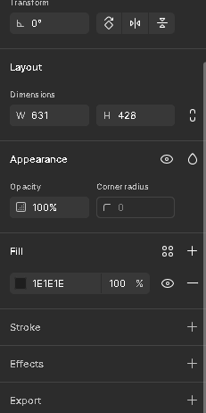
Step 4: Add color
Then we add the color in the shape ellipse from the features that are present for the modifications of shape.

Slide 25
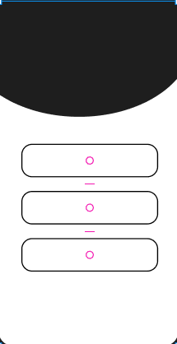
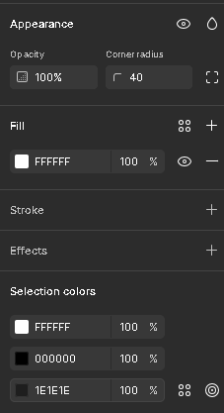
Step 5: adding boxes
Then we draw the boxes using rectangle from the shape sections.
Then we make their corners slight circular.
Then we apply stroke to them to make the boxes visible.

Slide 26
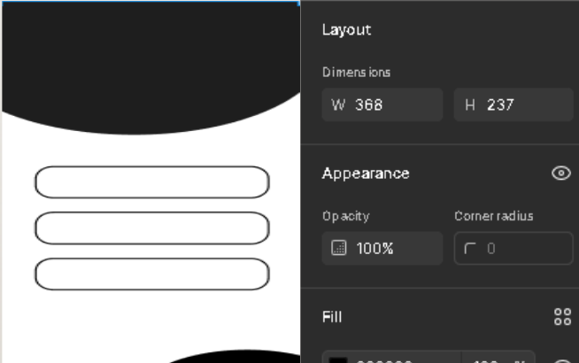
Step 6: adding last elipse
Then we again add the elipse from the shape section pf figma tool.
And adjust it in the frame .
Then we add color in that shape.
Then we add a line in that shape.

Slide 27
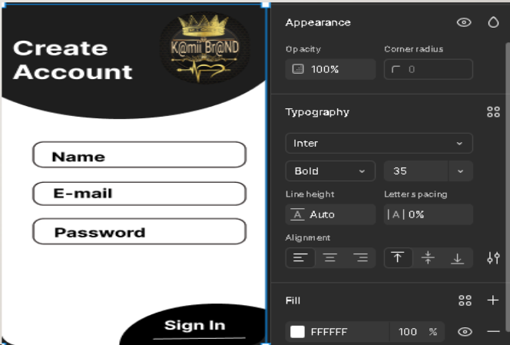
Step 7: adding text
Now we add the text to the frame by using text section from the figma tool.
And apply changes to the text e,g size boldness etc.

Slide 28
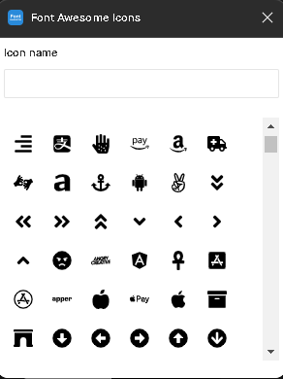
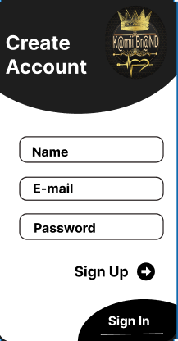
Step 8: adding sign arrow
Now we write sign up.
And add the sign arrow from the plugins.
These plugins we get from figma community.

Slide 29
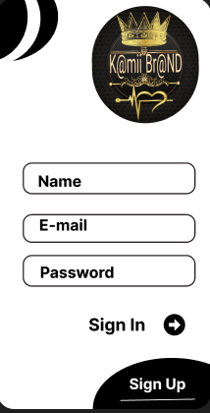
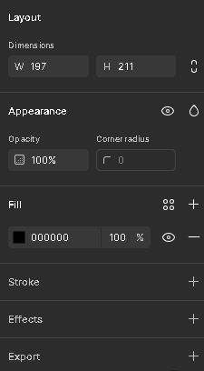
Step 9: Duplicating
Now we duplicate this page by using the shortcut key ctrl +d
Now we do some changes of shape and text with that page.
The text sign up wil be replaced by sign in and the text sign in will replaced by sign up.
The upper elipse will also be chaged.

Slide 30
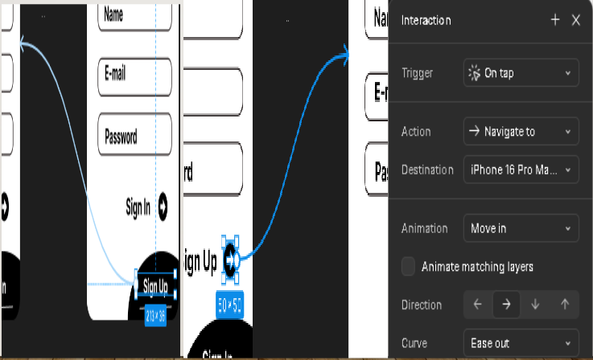
Step 10: prototyping
To show the prototyping, we first connect the both the frames.
Then we draw the arrow that connect sign up to other frame.
Then we draw the frame from last sign up ellipse to first frame.
And also put the animation on that arrow.

Slide 31
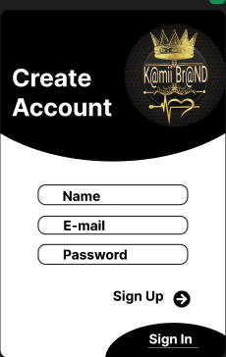
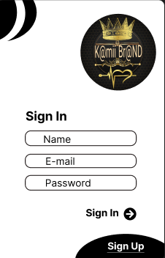
Wireframing
Wireframing is a very important concept for which figma is used.
Wireframing is the blueprint of digital product.

Slide 32
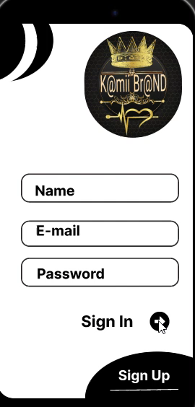
Step 10: Prototype video
Now we have connected the frames
Now we can run the prototype.
When we press sign up it moves to the sign in page.
When we press sign up on the last of second frame, it moves to the first sign up frame.

Slide 33

Pros of Figma tool
Real-Time Collaboration
Multiple users can edit and comment simultaneously.
Cloud-Based:
Work on projects anytime, anywhere.
Intuitive Interface
No steep learning curve, easy to start modeling.

Slide 34

Cons of Figma Tool
Internet Dependancy: Requires an active connection for optimal use.
Limited Simulation Capabilities: Focuses on static models and lack built-in-logic simulation.
Subscription cost: Advanced Features requires a paid plan to use them.

Slide 35

Pricing
Free Plan: Ideals for individuals or small teams.
Professional: For Advanced features and unlimited projects.
Organization Plan: Team libraries, analytics and advanced permissions.

Slide 36
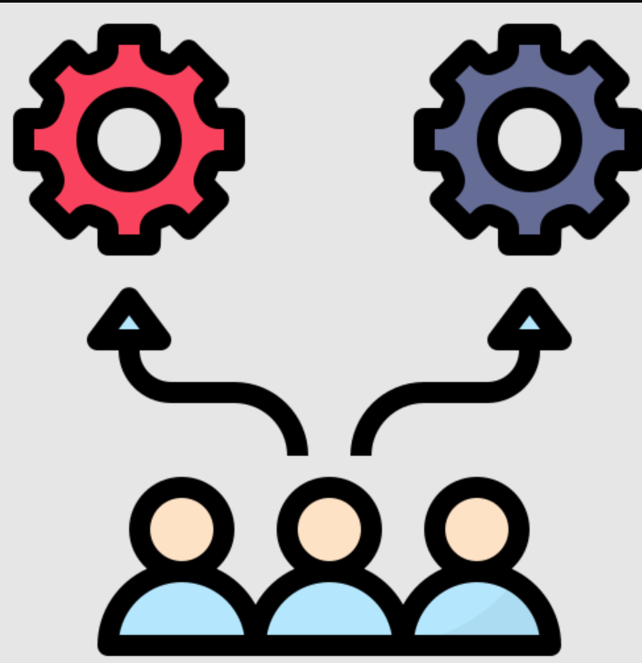
Other alternative tools
Sketch tool
Adobe XD
Invision studio
Moqups
Invision
Lunacy

Slide 37

Conclusion
Wireframing in Figma is an efficient way to plan and design the user interfaces, offering tools for both beginners and professionals.
Its intuitive interface, collaboration features, and extensive plugins make it a go-to choice for wireframing and prototyping.

Slide 38
THANK YOU
.

